Slide 1

Privacy
And
Voice Screening
For Environmental Sound Identification

Slide 2
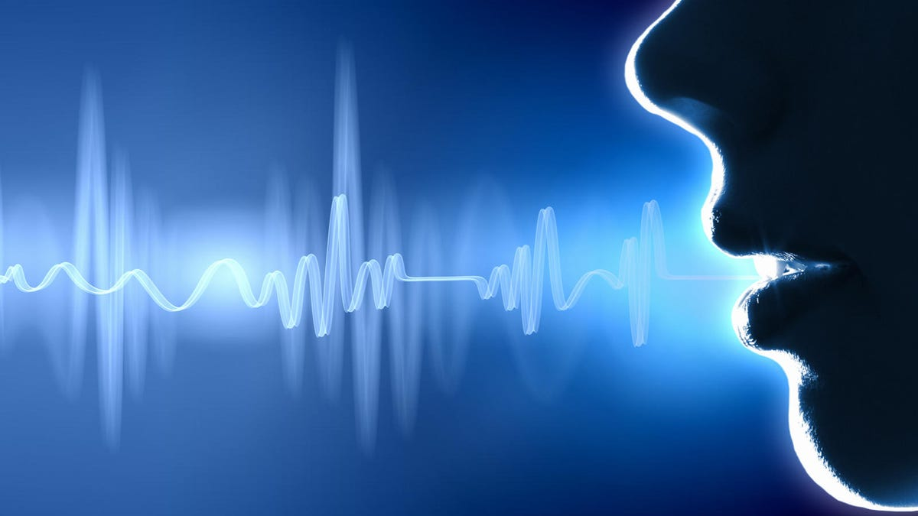

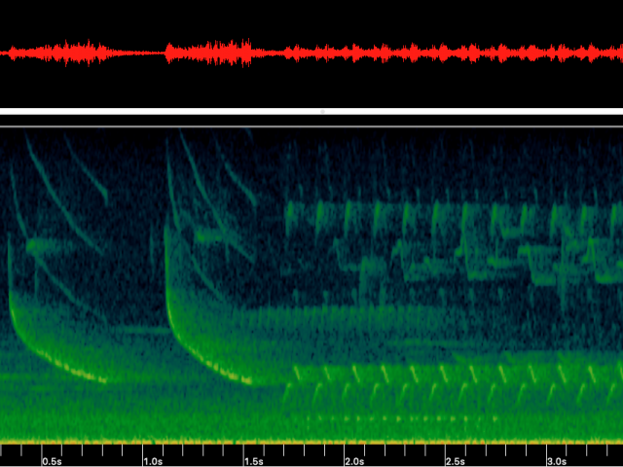
The Privacy Problem
How would you feel
if a private conversation was recorded
without your consent?
Notes:
Sensors are recording high quality audio data - what happens when someone has a conversation nearby?
The conversation is recorded & stored -> privacy issue

Slide 3

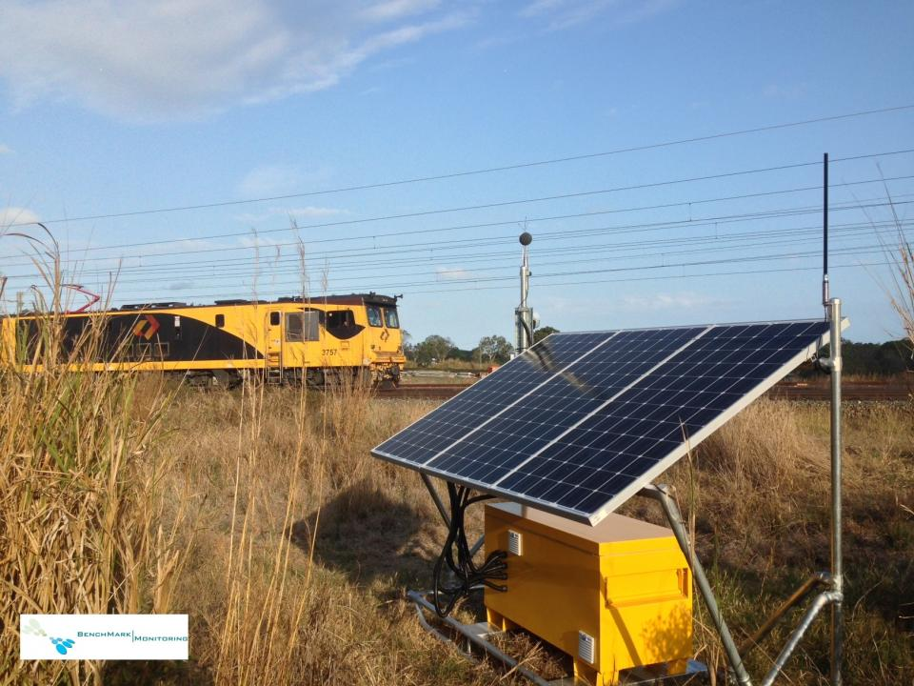
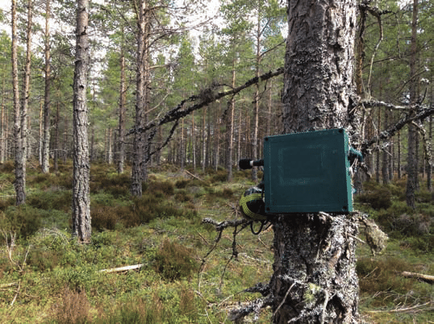
The Contexts : Environmental Sound Identification
For Industrial Noise Management
For Environmental Management
Notes:
ENvironmental sound identification - using AI/Machine learning to classify audio
Industrial applications: measure noise pollution, track vehicle movement
Environmental applications - survey bird/insect/frog populations, track human or animal movements

Slide 4
What is the Current Solution?
NOTHING!

Slide 5




The Solution - Pre-Screening
Preprocessing
ML Model – Voice Yes / No
Does this contain voice data?
Raw Audio Data
Yes
No
Discard data
Continue routine assessment
Notes:
Use a simple ML model immediately after recording
to identify data containing voice and exclude it from further analysis

Slide 6


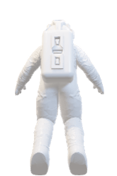
THA
NKS

Slide 7
Why our solution？
Minimal impact to the monitor’s function
Prevents sensitive data from being stored
Data is screened at earliest possible point in the process
Notes:
[see slide]
Importantly, it’s streamlined
By focusing on only whether data is voice or non-voice, much less computation is required than standard voice recognition

Slide 8



The Solution Details
Once sufficient data is cached (~5s), apply speech recognition model
Cache of input data
Input data 1/3 octave, short time step (<1 s, often 125 ms)
Speech recognised
No speech recognised
Cache data waiting for voice screening
Set data in cache to 0
(do not delete entry, just clear values)
Core data analysis/ML classification
Release cached data

Slide 9


Important Goals
The rest of the system works just as well
Adaptable inputs
Accurate classification
Traceability
Low resource use
行业PPT模板http://www.1ppt.com/hangye/
Notes:
Voice identification shouldn’t compromise the system’s function
Ideally work with whatever the system’s input is
Clearly record when data is excluded
Monitors are usually in remote environments - power and network connection comes at a cost
Ensure representative voice identification (vocal range, accent, language)

